Slide 1

The Evacuation App

Slide 2
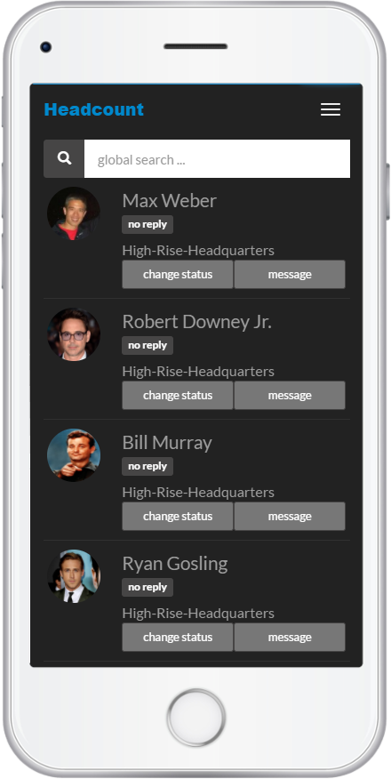
Headcount is an app that helps evacuation coordinators account for everyone.

Slide 3
Two Main Features
Evacuation Rosters
Messaging

Slide 4
Evacuation Rosters
Lists people you are responsible for
Tap a button to mark people as safe
Rosters synchronized in real-time

Slide 5
2. Messaging
Send messages to find someone’s location
Coordinate if things don’t go as planned
Check-in remotely via SMS and email

Slide 6
Select who should evacuate and send them an alert
Checking-in when not at the assembly point
Send the all-clear
Start Evacuation
In-Person
Check-in
Remote
Check-in
Sending
Messages
End Evacuation
Account for people at the assembly point
Find someone’s location. Coordinate if things don’t go as planned

Slide 7
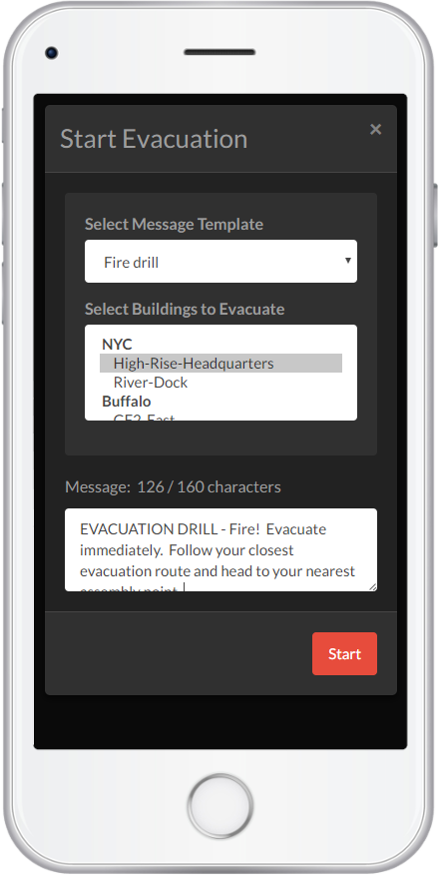
Start
Evacuation

Slide 8
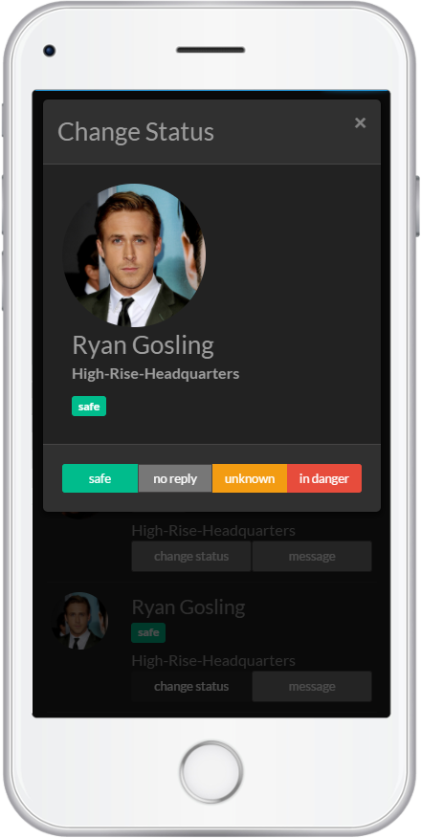
In-Person Check-In

Slide 9
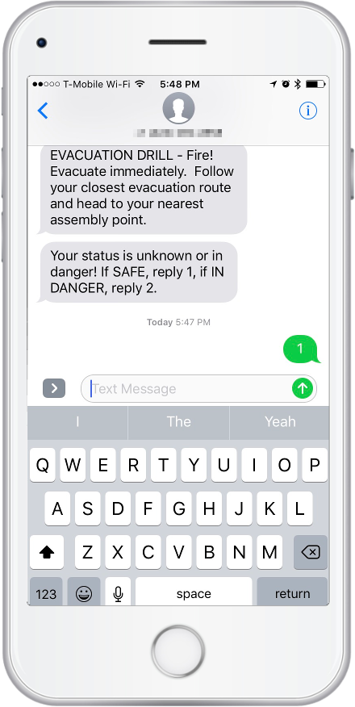
Remote Check-In

Slide 10
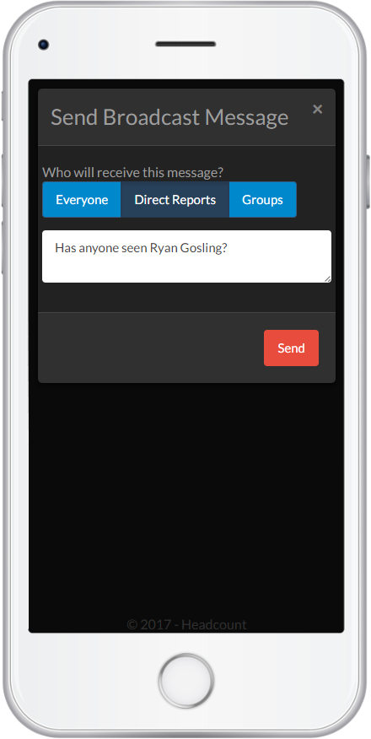
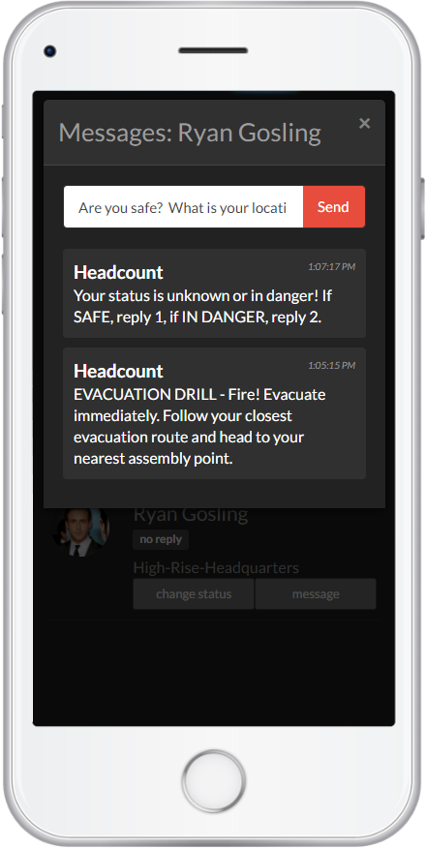
Sending Messages

Slide 11
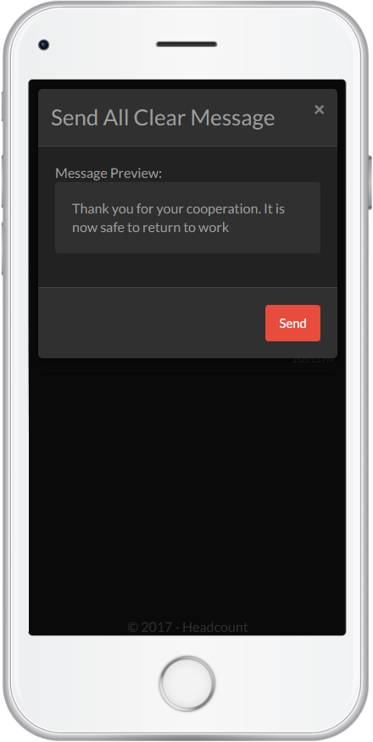
All Clear

Slide 12
Resources
A step-by-step guide for each action you need to take can be found in the Main Menu > Help screen.
The Help screen can be also be accessed from any web browser: https://app.headcount.io/help

Slide 13
Questions?
Send questions and feedback to
questions@headcount.io

